Slide 1



General installation guide for all types of vehicles

Slide 2
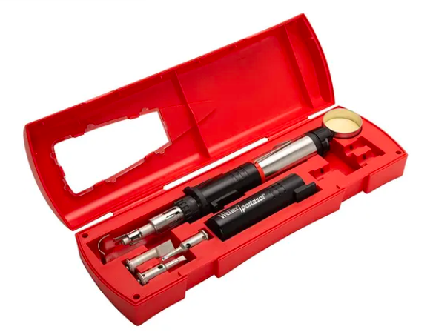









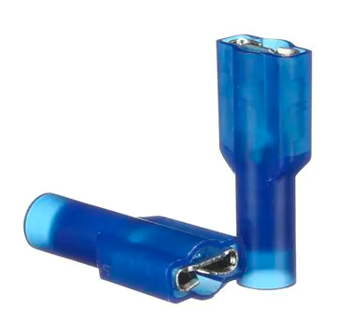
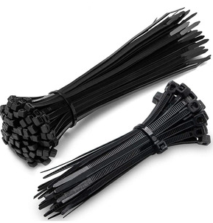
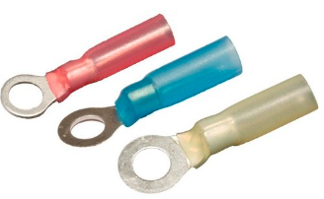


TOOLS AND MATERIALS (Suggested)
Soldering Iron Kit
Wire crimper
Diagonal Cutting Pliers
Screwdrivers Kit
Multimeter
Wire Stripping
Wrench set
Allen Wrench Set
Double Sided Tape 3M
Heat Shrink Connectors
3M Female/Male Connector
Zip Ties

Slide 3

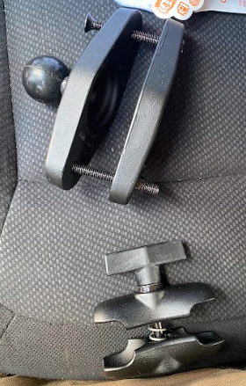
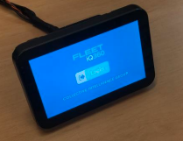
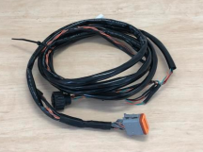

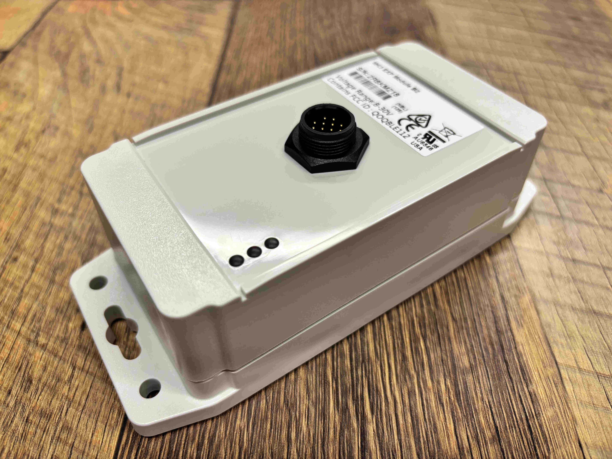
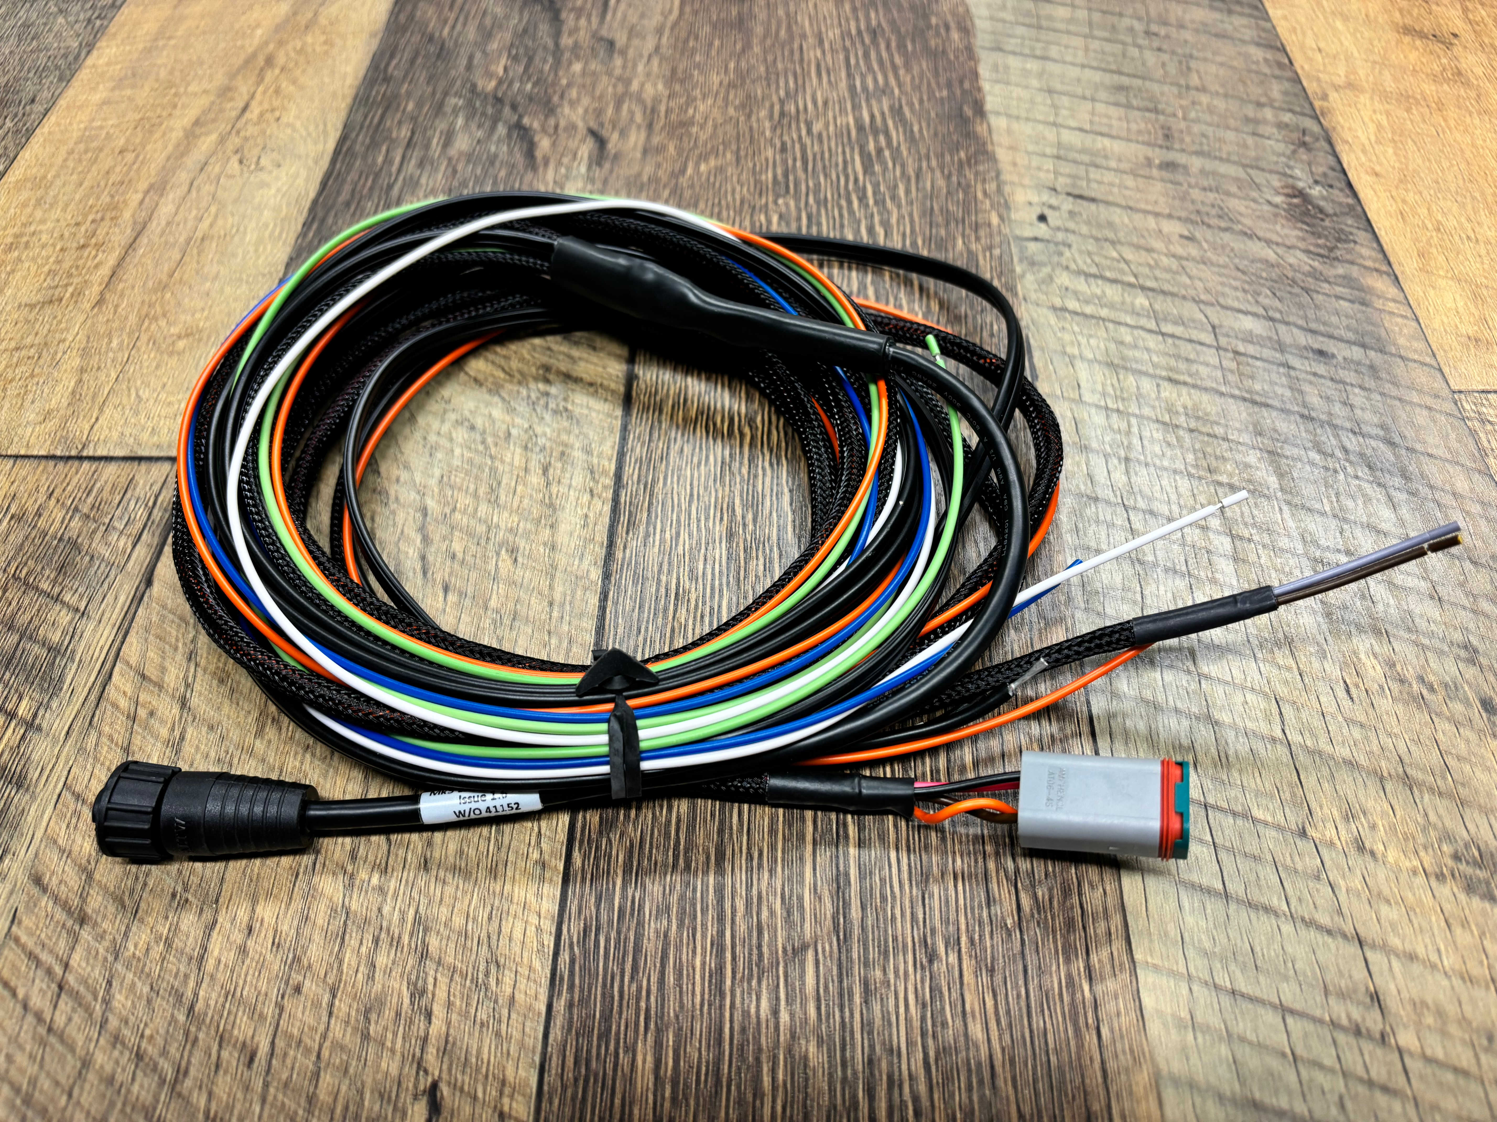
Kit Components
A standard Fleet iQ360 kit consists of the following components:
Main Module
Main Module Harness
Mounting Bracket & Screws
RAM Mount
Expansion Module
Expansion Module Harness

Slide 4
Overview
The two main components of the system are the main module and the expansion module. These connect to each other with the expansion module harness.
  The MAIN MODULE connects to the vehicle and is powered by the vehicle via the main module harness. It contains a 7” Touchscreen LCD for driver access and pre-op questions, an internal EM/HID RFID reader, as well as the smarts of the system including a microprocessor, memory, back up battery and a 4G modem for communicating to the central database.
  The EXPANSION MODULE connects to the expansion module harness which in turn connects to the main module harness. This is also powered by the vehicle and contains 2 normally open relays, 4 GPIO inputs and an accelerometer. Multiple expansion modules can be chained together to increase system capacity. The expansion module’s green light will flash slowly when powered up.

Slide 5
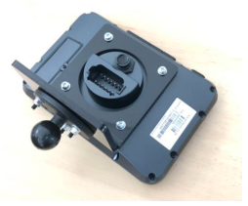
Position Main Module
The main module contains the driver interface and needs
to be located within easy reach of the driver. Typical mounting locations would be:
• On the dash panel,
• Firewall,
• On the overhead guard pillar.
It mounts to the vehicle using the supplied adjustable RAM mount and must be mounted in a position that does not obstruct the driver’s vision, any warning or compliance plates and does not impede the operation of the vehicle.
Using the supplied set of three M4x16 bolts, washers and Nyloc nuts, attach the RAM base to the mounting bracket, then using the set of four M4x12 bolts, flat washers and spring washers, attach the mounting bracket to the rear of the main module.

Slide 6
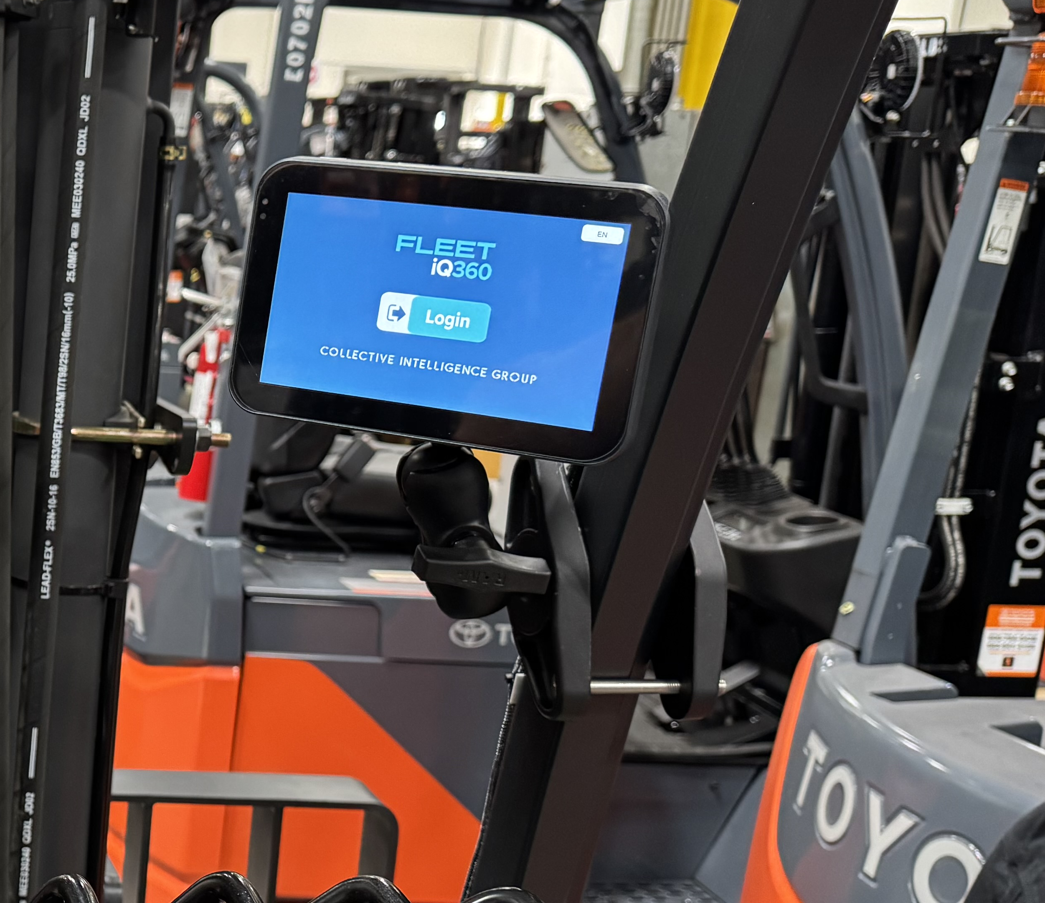
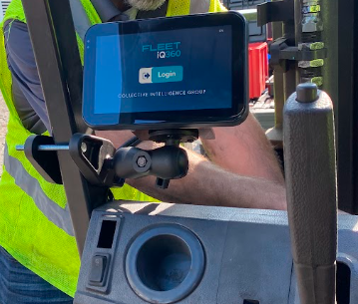
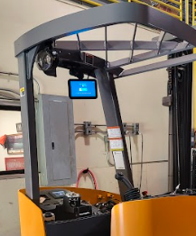
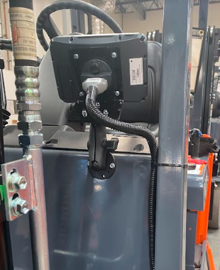
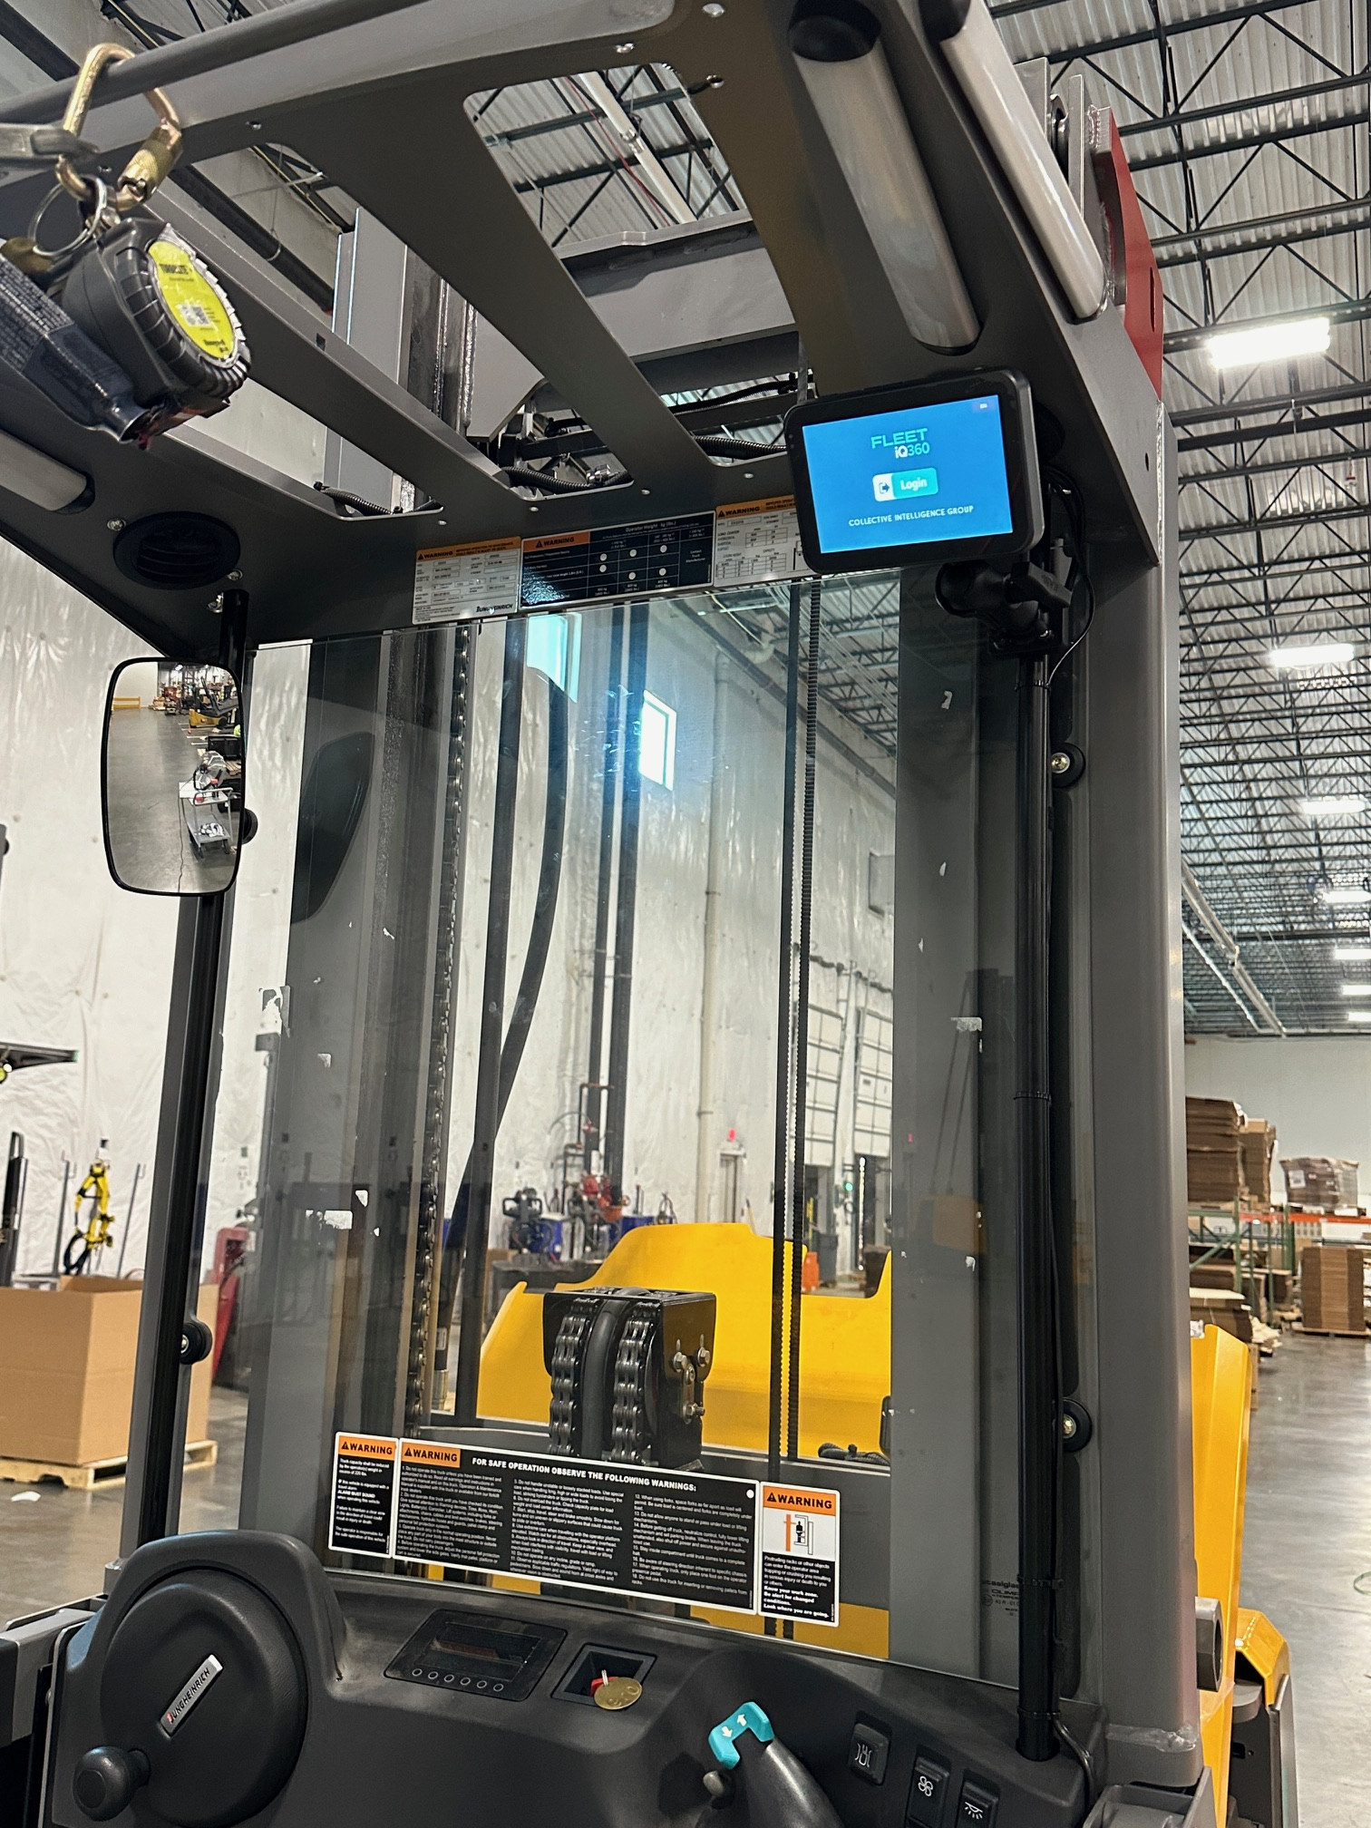
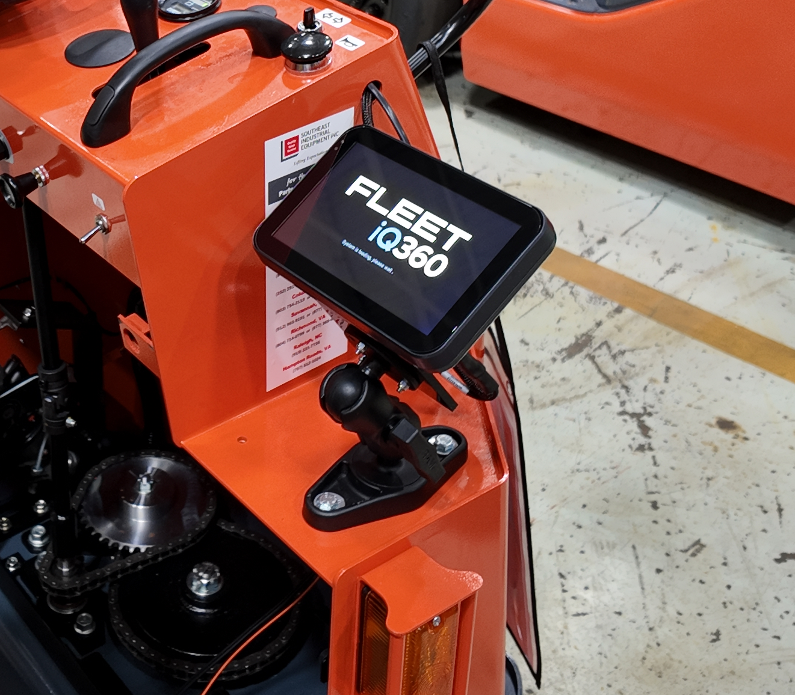

Slide 7
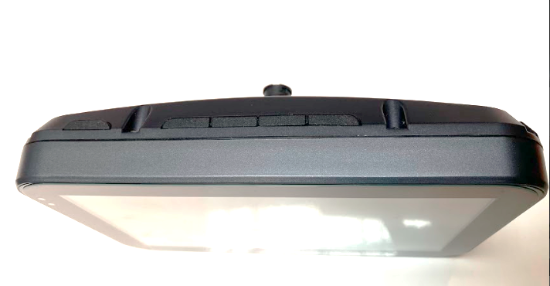
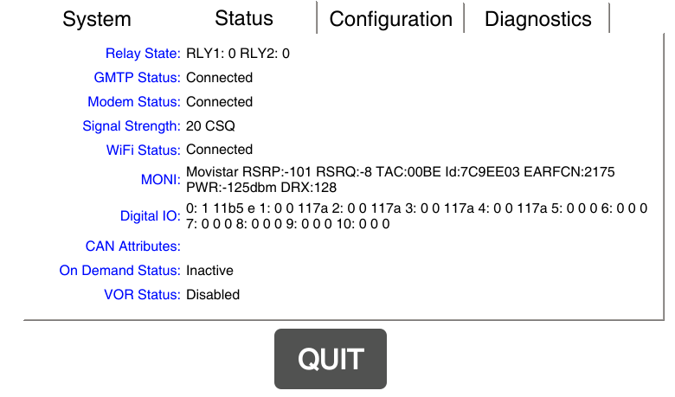
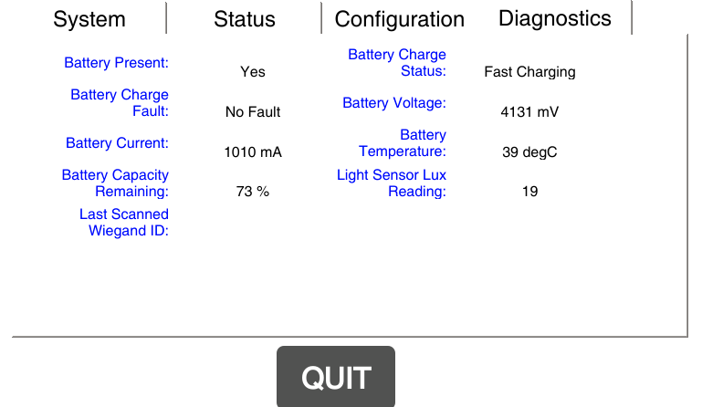
DIAGNOSTICS
At the top of the Fleet iQ360 screen. We will find 5 buttons, press from left to right the buttons 2, 3 and 5 at the same time:
You will find some informative windows where you can:
View the mobile connection status of the main Module, where the GMTP and Modem should appear connected.
In case the connection is through WIFI it should appear connected.
Be able to see the condition and diagnostics of the Main Module battery (Screen).

Slide 8
Position Expansion Module (EM)
The expansion module (EM) contains an integrated accelerometer.
To reliably detect impacts it needs to be mounted to the vehicle’s chassis,
but not in a position that can be kicked or knocked by the operators.
• Use double-sided tape/nuts/bolts to secure the module to the vehicle.
• Avoid areas (engine bay) where temperatures will exceed 70⁰C (160⁰F)
• Locating close to electric motors, distributor, high tension leads may cause interference to the expansion module.
• Secure the harness as appropriate so as not to create unnecessary stress and away from moving parts such as hydraulic rams.
*These positions are a recommendation only and the installer is responsible for the final position of the unit, ensuring that it does not affect the safe operation of the vehicle*

Slide 9
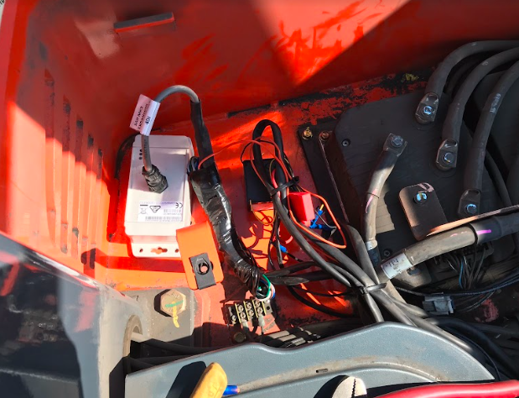
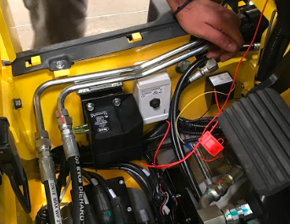
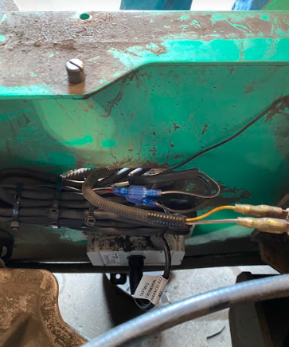
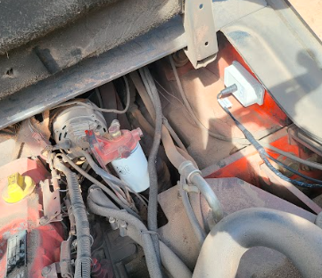
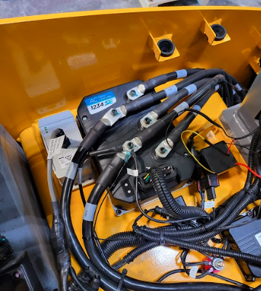

Slide 10
DIAGNOSTICS
The following is the diagnostic to evaluate the status of the Expansion Module:
EXPANSION LED | STATUS | CONDITION | ACTION
GREEN | Flashing | Module operating normally | None required
GREEN | On Steady | Module is locked up | Reboot module
GREEN | Hydraulics | Module is off | Check power to Expansion module (red and black wires from main module should have 12v.)

Slide 11
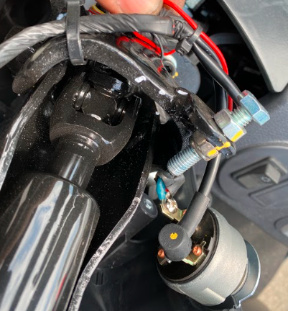
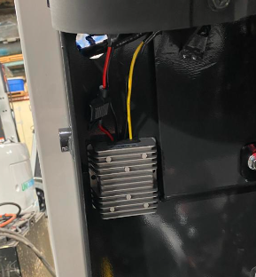
POWER CONNECTIONS
The main module has two power wires:
RED: Connects to a key switched voltage of between 10v and 30v DC. Over 30v will cause damage to the module.
BLACK: Connects to the vehicle’s battery negative.
** Power Converters are required on vehicles over 30v **

Slide 12
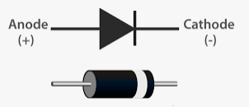
INPUTS
The expansion module contains 4 digital inputs. These are used to measure time related events for functions such as seat, engine, traction usage. The standard configuration is:
Input # | Wire Color | Function
1 | White | Hydraulics
2 | Blue | Traction
3 | Green | Spare
4 | Orange | Seat
** It is required to put diode (1N4004) in the inputs if they are electric vehicles. ** (The cathode should go to the EM)
When they detect a voltage, that input is reported as ‘ON’, eg. Alternator output or traction solenoid. If the seat switch switches between open circuit and negative, a relay may be needed to switch power to the input.
Operating ON voltage range is from 5-55v DC.
Operating OFF voltage is 0v DC.

Slide 13
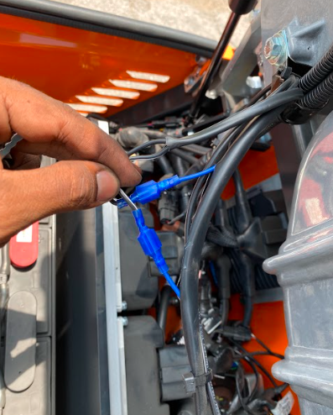
OUTPUTS
The expansion module contains two normally open relays.
Relay 1 (Cut-out) is the driver authorization relay and will close once an authorized driver has successfully logged onto the system. Relay 1 is the black and black/white wires on the harness.
The connections to the vehicle will be dependent on the type and model of vehicle and as recommended by qualified personnel to maintain safe operation of the vehicle. However, as a general guide:
  IC vehicles – in series with either the seat switch or the low power side of the starter motor (remembering the 3A current limit of the relay)
  Electric vehicles – in series with the seat switch.
Relay 2 is the lockout relay and will close once a driver has logged on and (1) a mandatory pre-op check is not required, and/or (2) an impact or pre-op lockout does not exist. Relay 2 is the brown and grey wires on the harness.
*Both relays have a maximum switching current of 3A @ 30v DC*

Slide 14
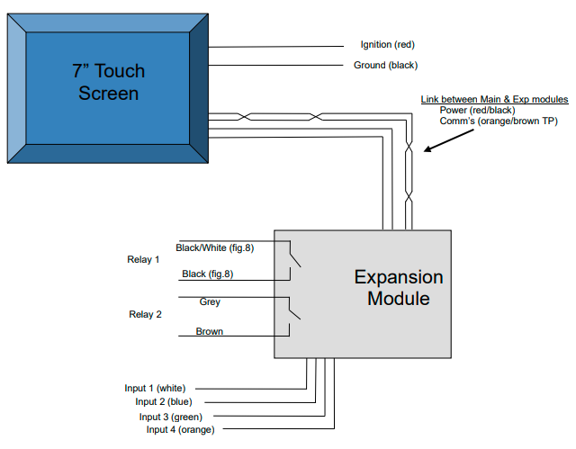
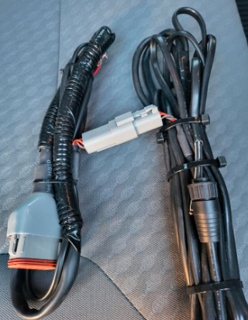
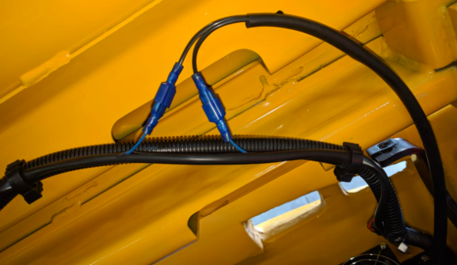
BLOCK DIAGRAM
** Power Converters required on vehicles over 48v **

Slide 15
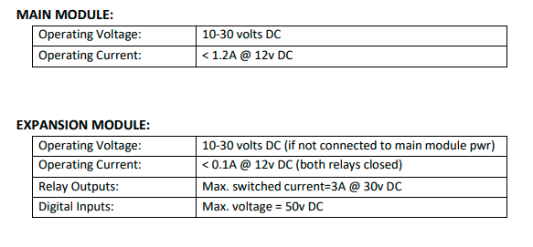
Electrical Specifications:

Slide 16
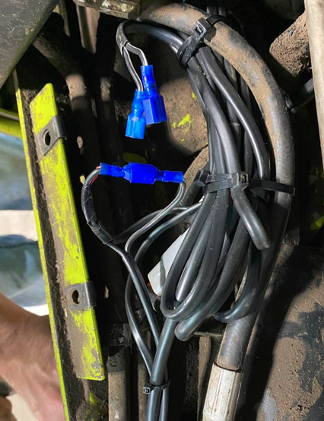
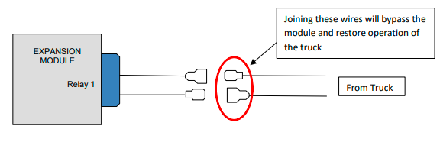
BYPASS
If the module malfunctions and prevents the driver from logging on, then the system can be bypassed to ensure the vehicle remains operational until the malfunction is rectified. This is done by disconnecting the harness’s black and black/white wires (relay 1) from the vehicle and joining the two connectors on the vehicle as shown below.
The installer will need to supply and install connectors to suit the vehicle. 3M connectors are ideal for this connection, with opposite polarity as above.
**The bypass location should only be known to authorized technicians and Supervisors/Managers.**

